Slide 1



Trajectory Prediction
By Komkov Stepan, Petyushko Alexander

Slide 2
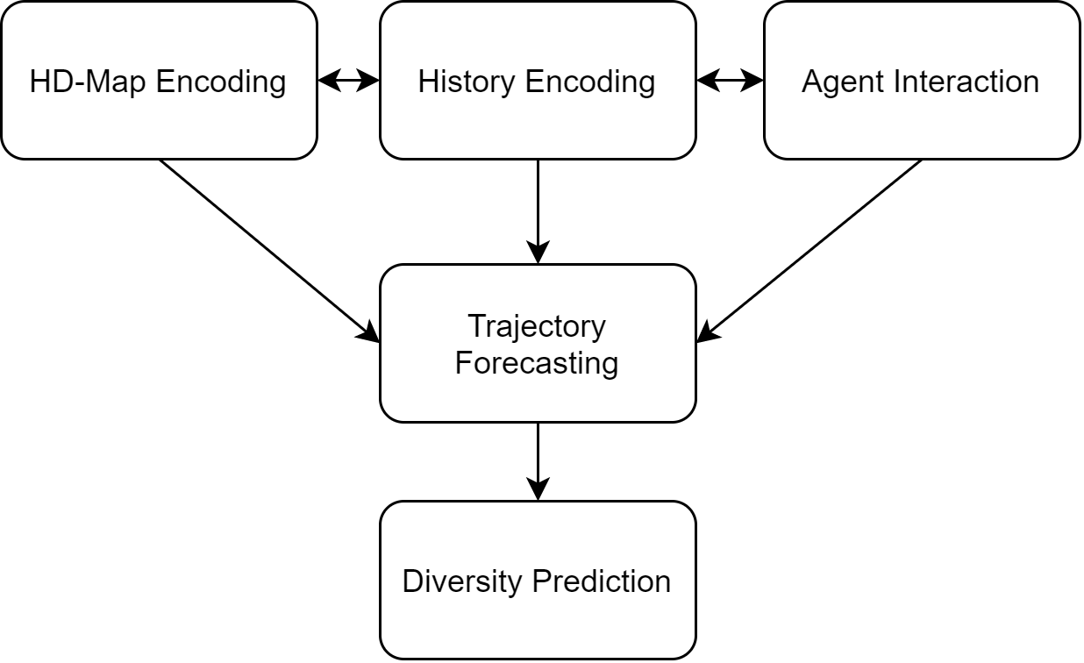
Common Trajectory Prediction (TP) block scheme
Encoding part
Decoding part

Slide 3
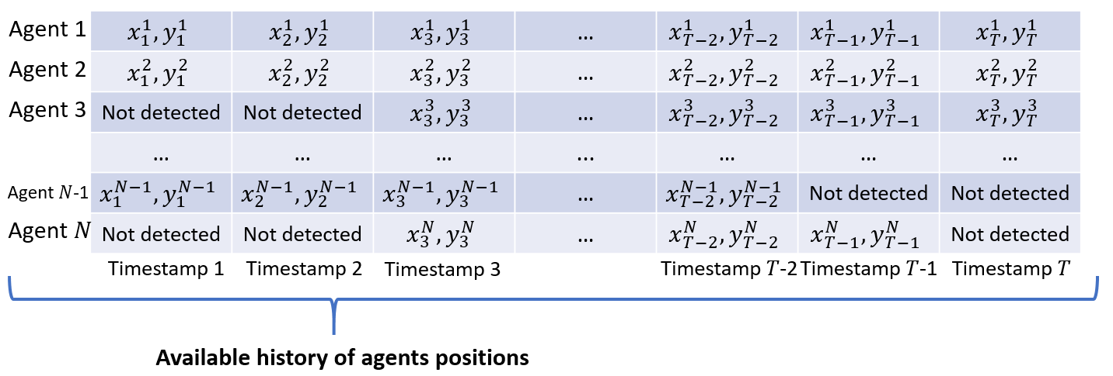
History Encoding
One of two obligatory parts of the TP-block
Input:
Always receives history of known positions of each agent during the last N timestamps
With some missed observations maybe
May also receive other agent meta-information:
Agent type: vehicle, cyclist, human, etc.
Agent movement: velocity, acceleration, etc.
Agent state: heading, width, length, etc.
Agent signals: turn signals, stop-lights, etc.
Any other possible agent information
May be provided for each timestamp depending on the nature of the characteristic

Slide 4
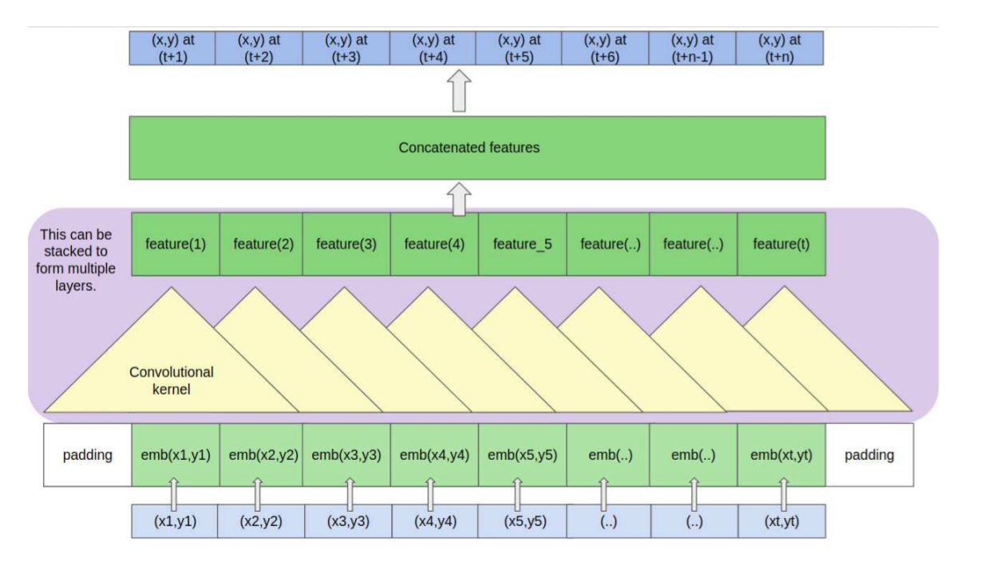
History Encoding
Ways of realization
Since the number of observations is limited, we can apply ordinary Multi-Layer Perceptron or 1D-Convolutional Neural Network
1 instance = 1 trajectory
Trajectories are processed independently at this point

Slide 5
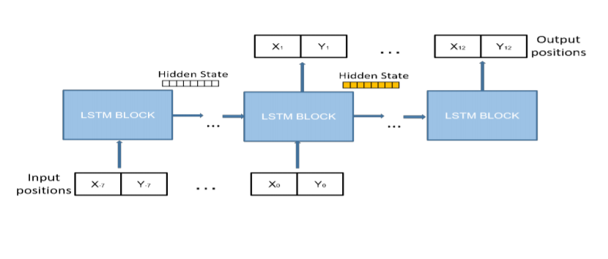
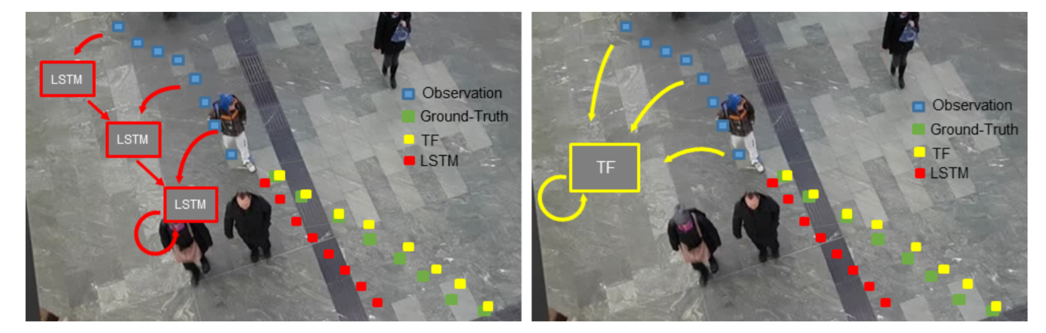
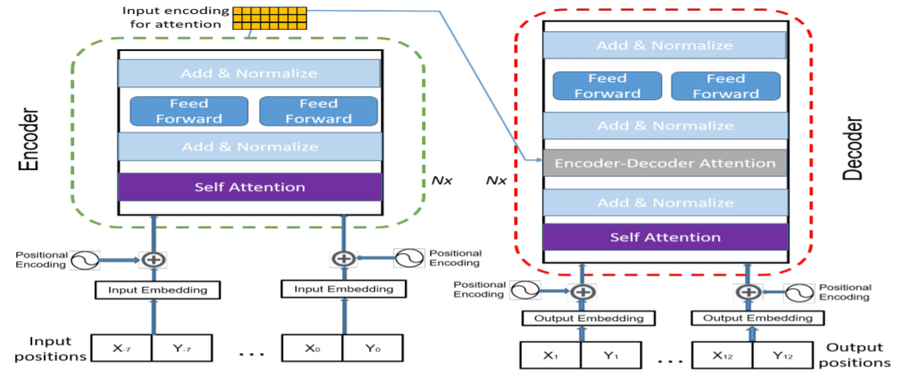
History Encoding
However, the nature of data is sequential
That is why most of the solutions use LSTM for history encoding
An increasing number of works use Transformer-based solutions for encoding
The state-of-the-art (SOTA) architecture for processing of sequential data
Still 1 instance = 1 trajectory

Slide 6
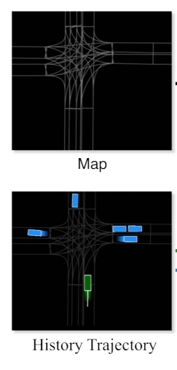

History Encoding
The most straightforward way
Bird-view scene rendering with further 2D CNN processing
Snapshot of each timestamp for different channels or tail drawing
Can be easily fused with HD-Map

Slide 7
History Encoding
Output
In general, the output of the History Encoding block is a set of feature vectors for each agent in the scene
These feature vectors may be generated independently (the easiest but the weakest way)
Considering HD-Map
By the exchange of information with other agents in the scene
By both HD-Map and Agent Interaction

Slide 8
Agents Interaction
Positions and actions of other agents are important for the forecasting
Agents Interaction can be applied during the History Encoding stage or as post-processing of the History Encoding stage
If interaction takes place during encoding then it influences the output feature vector of the History Encoding block
If interaction takes place after encoding then it uses the History Encoding output as an input and outputs another feature vector for the agent

Slide 9
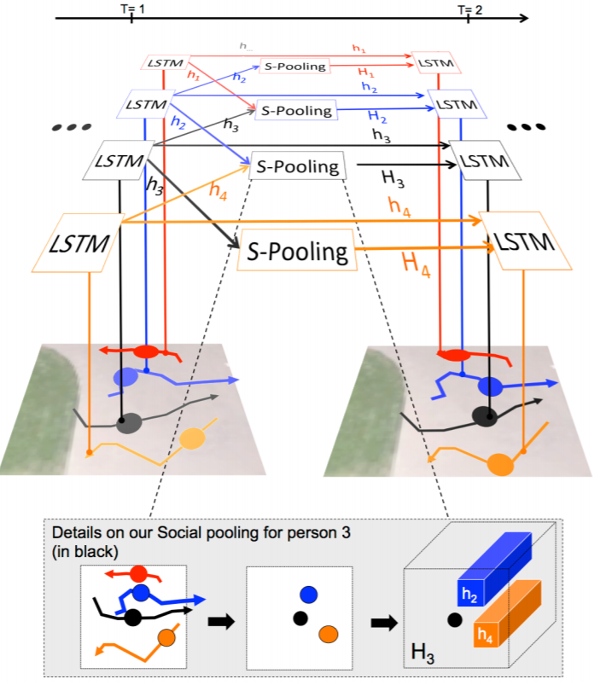
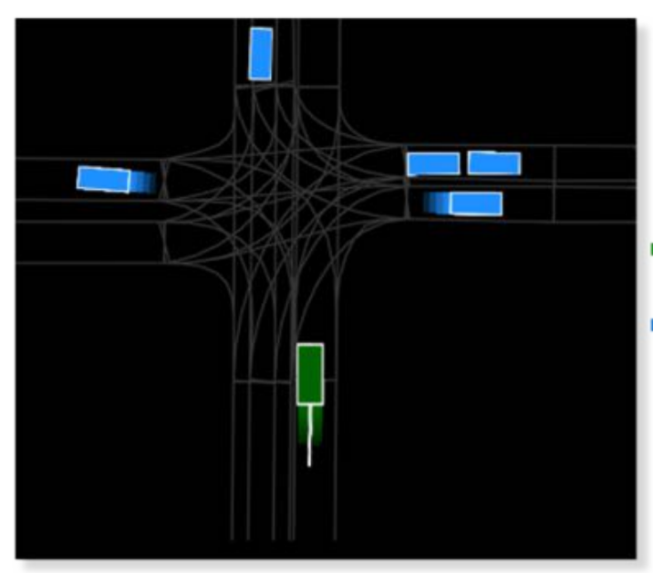
Agents Interaction
Interaction during History Encoding
If we use scene rendering then it is reasonable to render other agents too
Social Pooling Methods
We will discuss them in more detail later

Slide 10
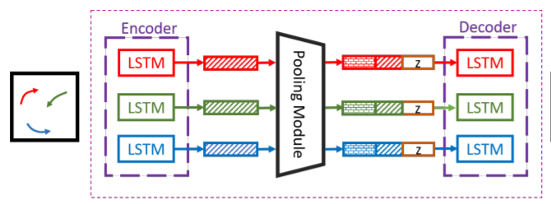
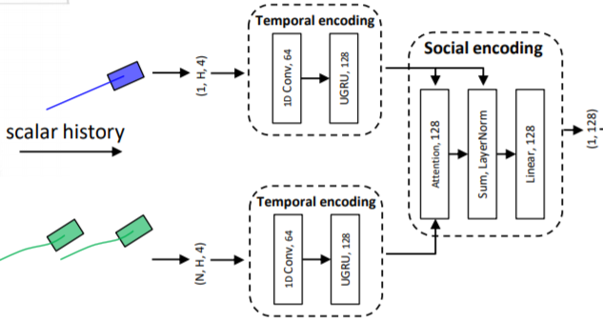
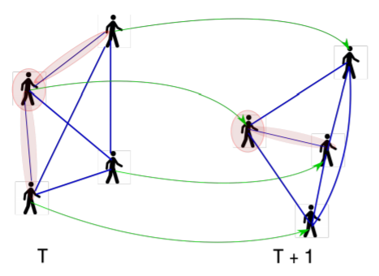
Agents Interaction
Interaction after History Encoding
Social Pooling Method can be applied only once
Various Transformer-based and Graph CNN-based solutions

Slide 11
HD-Map Encoding
There are two major approaches for HD-Map encoding
Map rasterization
We render the whole scene to the multi-channel picture to process with some image-targeted model
Map vectorization
The nature of data is scalar
History is stored as a set of coordinates
Even HD-Map is stored not as a picture
Lanes are parameterized by uniform key points. The same for road centerlines, traffic lights positions, etc.
The recent approaches switch to this way

Slide 12
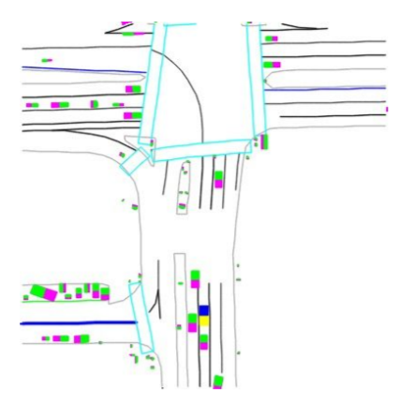
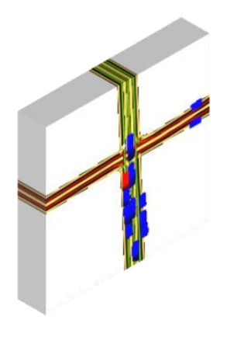
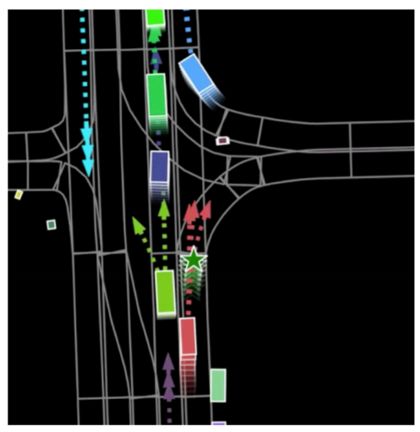
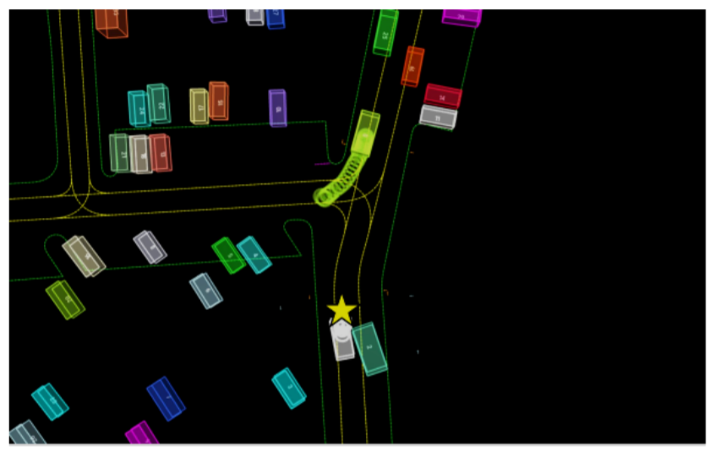
HD-Map Encoding
Map rasterization
A wealth of various ways to rasterize HD-Map depending on the available information
Further, 2D CNN processes the map to obtain the feature vector of the map

Slide 13
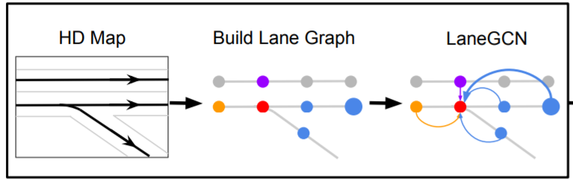
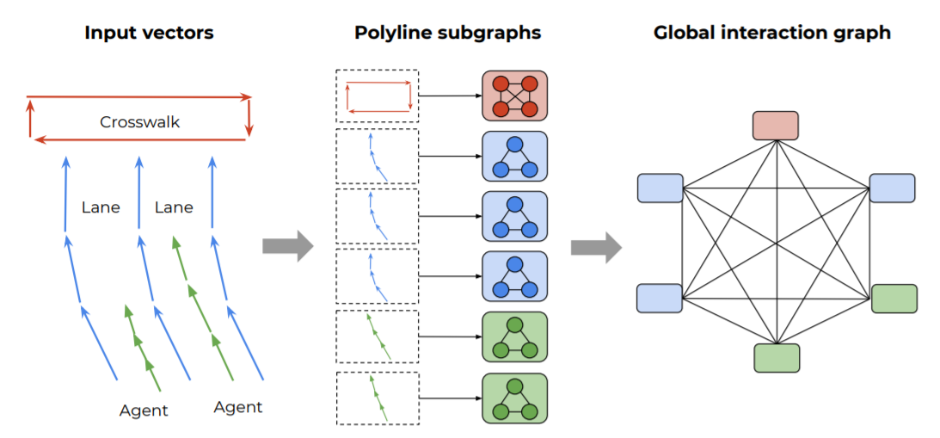
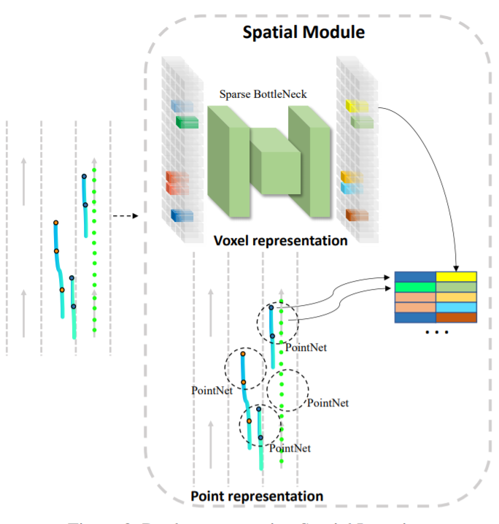
HD-Map Encoding
Map vectorization
Graph CNNs mostly
But there are Transformer- and even Point Cloud-based methods

Slide 14
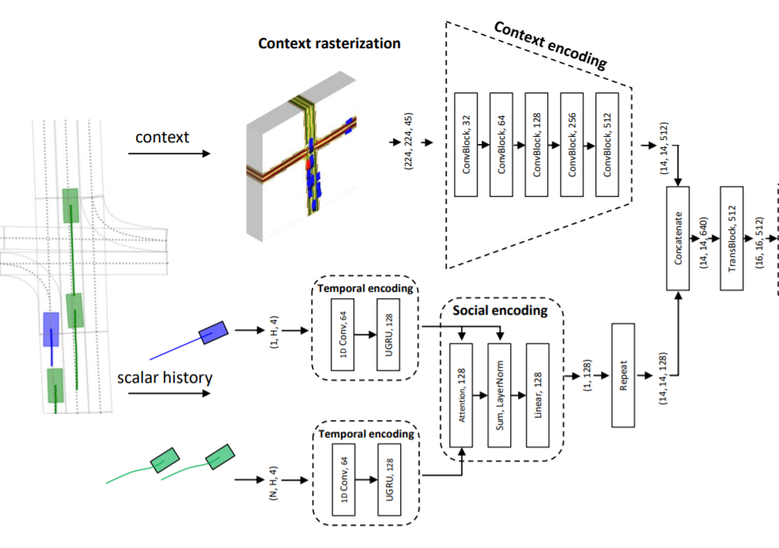
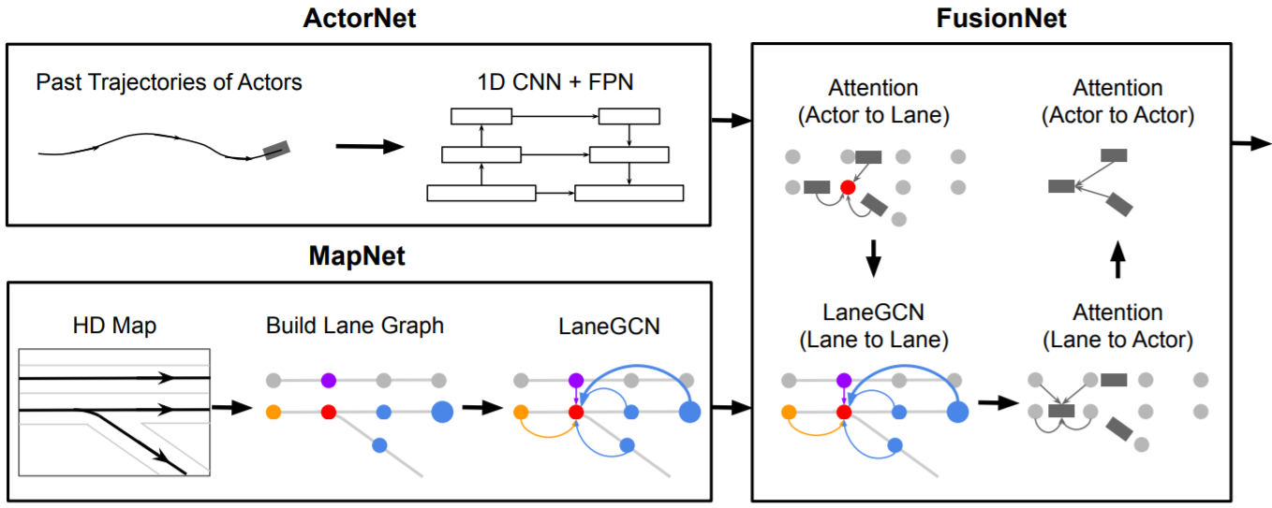
Blocks Fusion
All three described blocks work together
The target is still the same as for the History Encoding block – to output a feature vector for each agent.
Based on this vector, a decoder will make a forecast

Slide 15
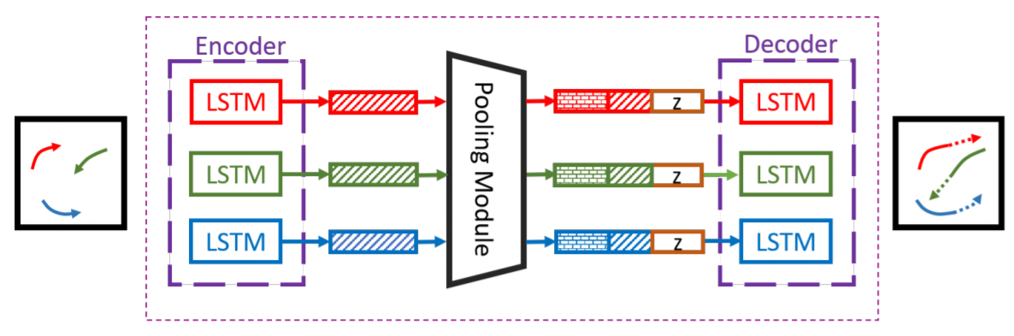
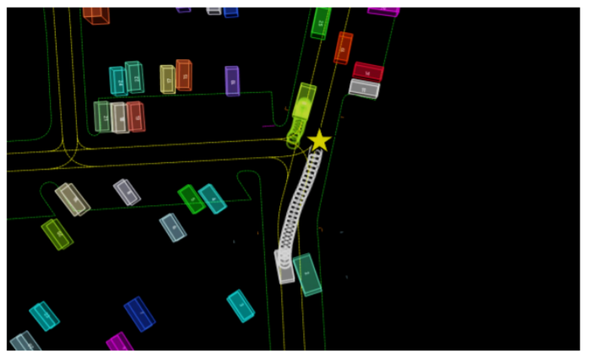
Trajectory Forecasting
The second one of two obligatory parts of the TP-block
Input
Feature vector per agent
Output
Representation of the future trajectory
Can be represented as a scalar data (future coordinates)
Prediction by the Fully-Connected layer for example
Can be also represented as a drawing of the future trajectory
We can predict the full future trajectory once or do it in an autoregressive manner

Slide 16
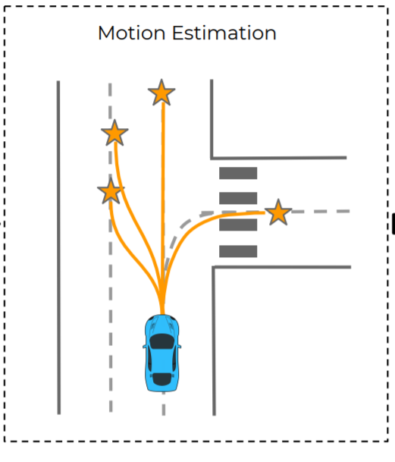
Diversity Prediction
The future is not deterministic
There are several possible scenarios
We need to predict them
There are four common types of diversity prediction:
Multi-prediction
Sampling-based
Anchor-based
Goal-oriented

Slide 17
Prediction of Possible Trajectories
Some of Trajectory Forecasting methods are inseparable with Diversity Prediction
Note that we can predict only one trajectory using any Diversity Prediction method by getting the most probable one
That is why we will consider these two blocks together

Slide 18
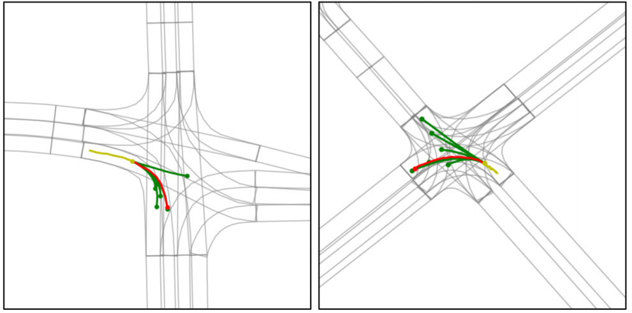
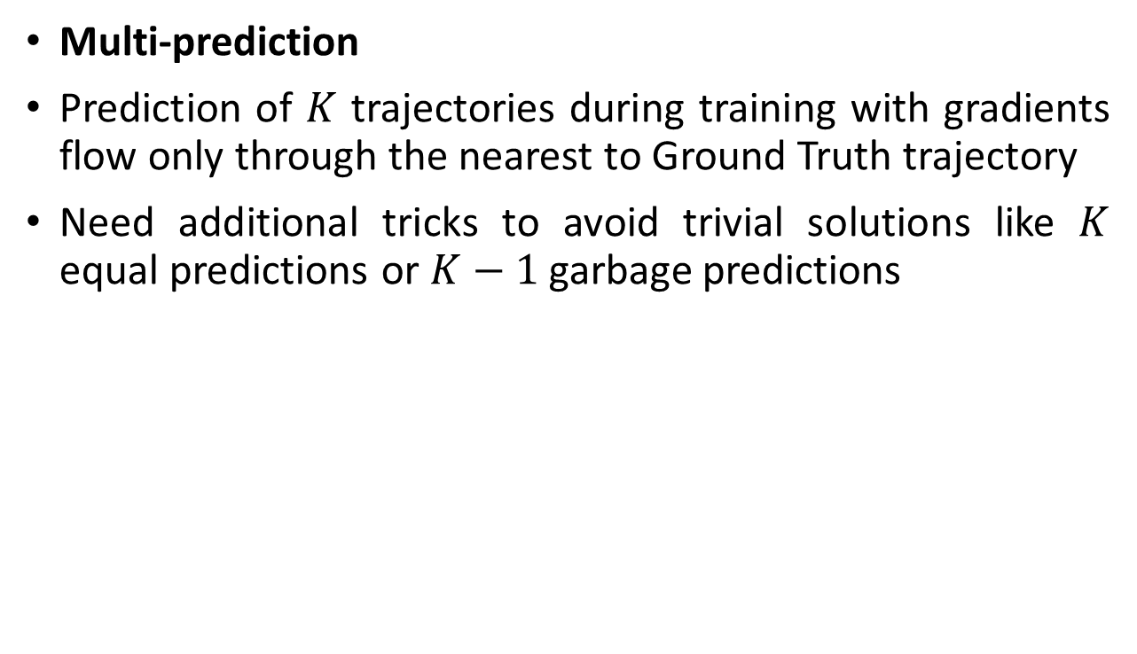
Prediction of Possible Trajectories
Multi-prediction
Prediction of $K$ trajectories during training with gradients flow only through the nearest to Ground Truth trajectory
Need additional tricks to avoid trivial solutions like $K$ equal predictions or $K−1$ garbage predictions

Slide 19
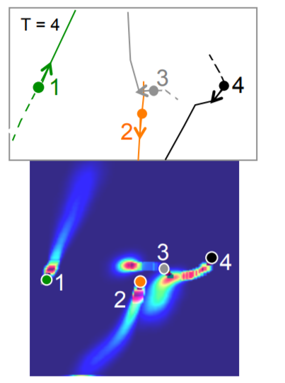
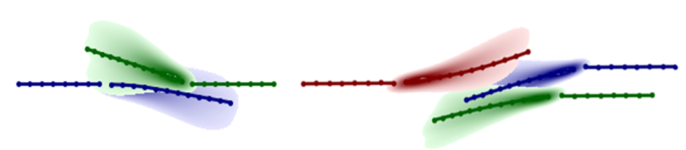
Prediction of Possible Trajectories
Sampling-based
A canonical example is a Bivariate Gaussian prediction
We consider movement in each timestamp as an instance of a random variable with bivariate Gaussian distribution
During the training, we optimize means, standard deviations and correlation coefficient by the negative log-Likehood loss
During the inference, we sample movement for each timestamp from the predicted parameters for this timestamp
Cases with the discrete distribution belong to Anchor-based Diversity Prediction in our dichotomy

Slide 20
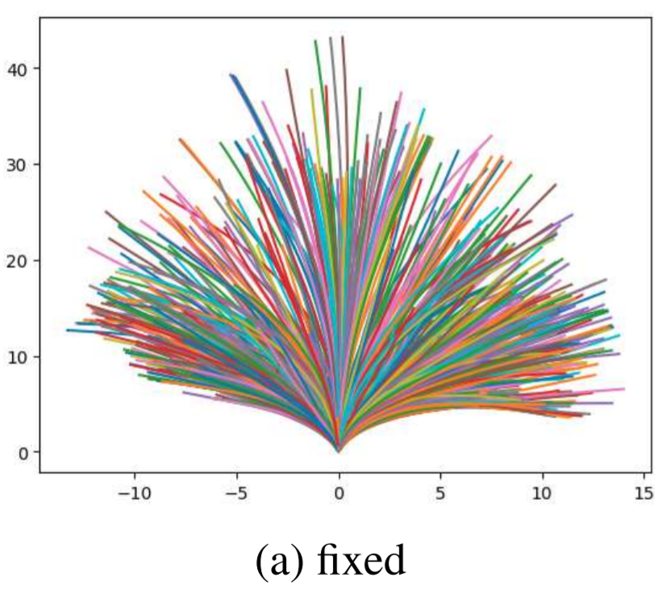
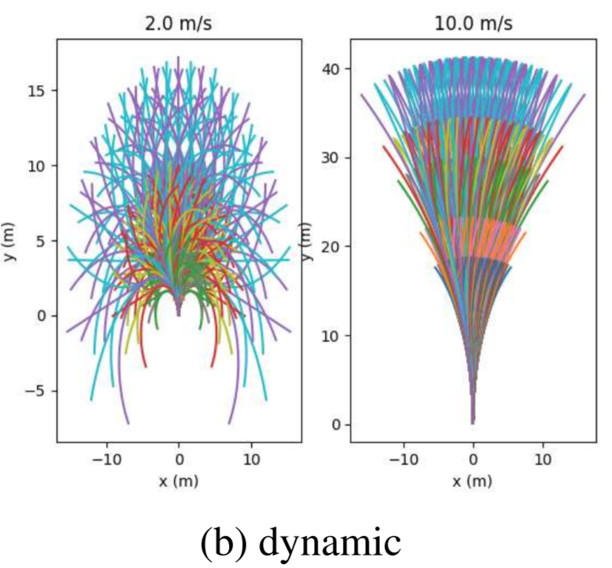
Prediction of Possible Trajectories
Anchor-based
We assign probabilities for some predefined set of possible trajectories
We can take the K most probable trajectories but they are close to each other usually
Therefore, various tricks are used to prevent it
An anchor set can be generated by clustering of the training trajectories (average trajectory from each cluster)
The anchor set can also be generated by some rules for possible trajectories
As an expansion of this idea, the set may be generated dynamically based on the agent velocity
The mix of these sets performs the best

Slide 21
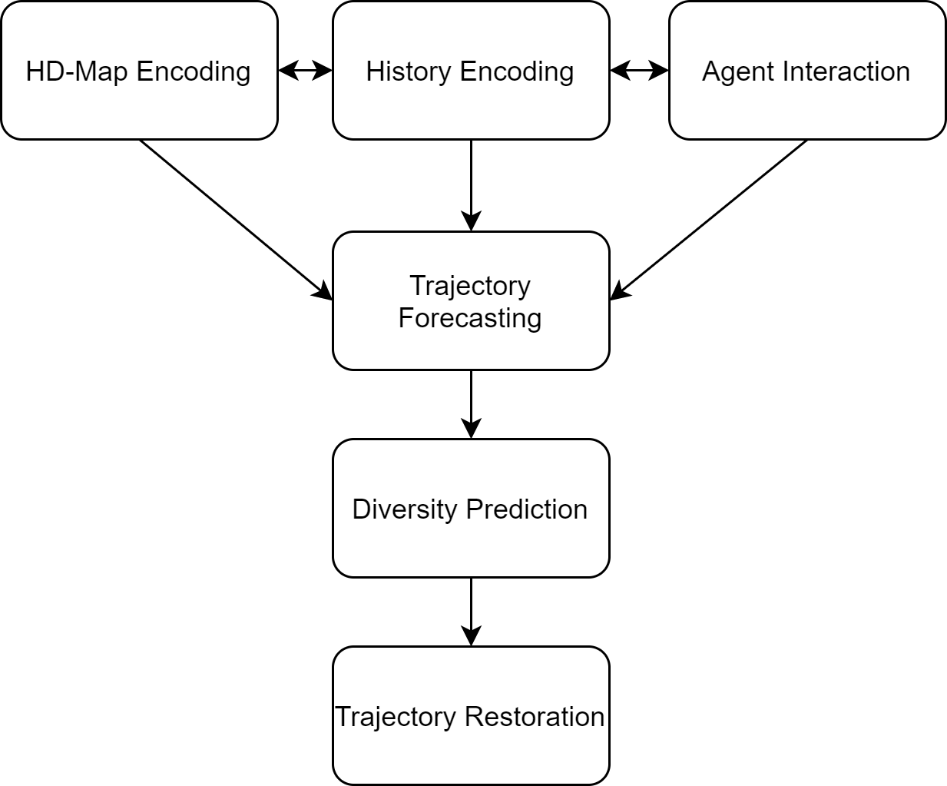
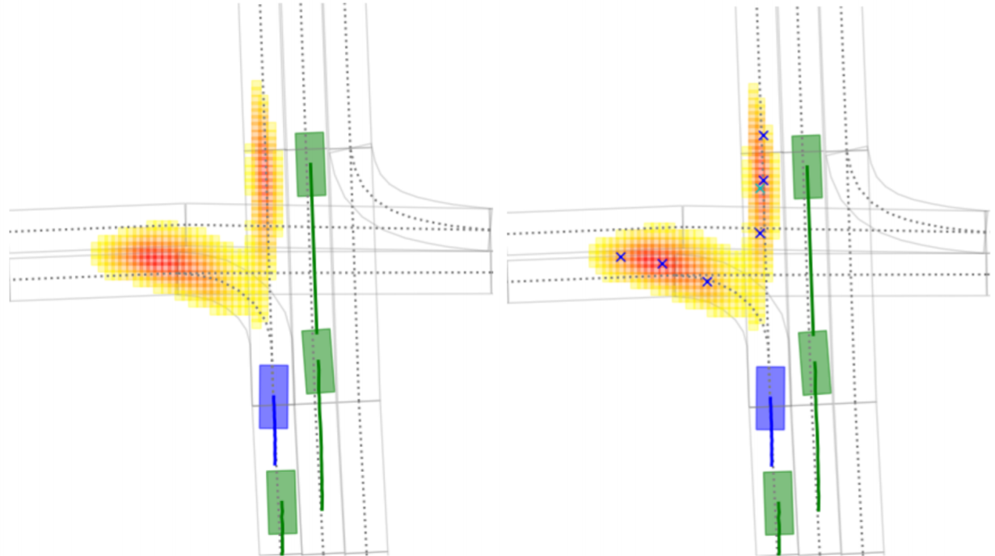
Prediction of Possible Trajectories
Goal-oriented
We do not predict trajectory itself but predict the target destinations of agents
Thus, we need an additional block that restores trajectories to the selected points
The common realization can be described as follows:
Assigning the probabilities of being the destination point to some points on the scene
We can assign probabilities to all nearest points in the scene
We can assign probabilities to points in the drivable area only
Points lattice also varies: it can be regular or can be related with lanes from HD-Map
Choosing K diverse target points
Trajectories reconstruction to these points

Slide 22
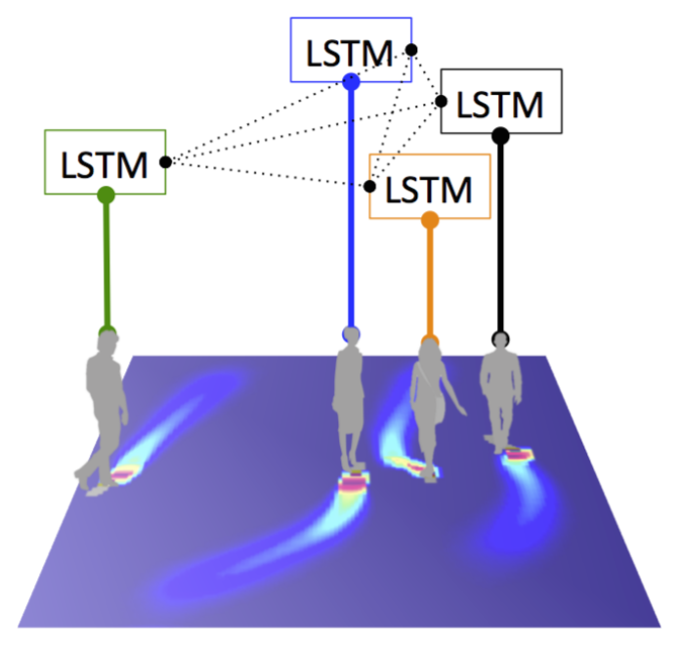
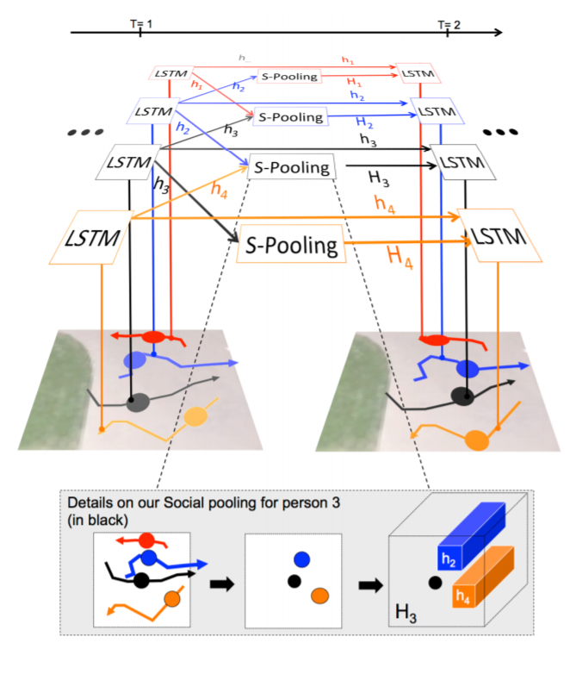
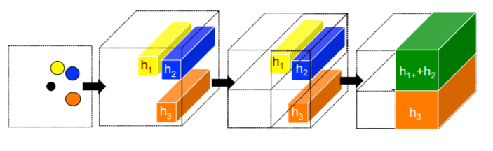
Classical Baseline: Social LSTM
History Encoding: LSTMs with shared weights process trajectory (2-valued scalar input) of each agent independently in an autoregressive manner
Hidden states are concatenated with the context feature vector during each iteration
Agents Interaction: Social Max-Pooling mechanism
Hidden feature vectors of the agents are placed according to agents coordinates
For each agent, we construct a feature vector of the surrounding context using these feature vectors and their relative positions
Trajectory Forecasting: LSTMs with shared weights forecast the trajectory of each agent independently in an autoregressive manner
Diversity Prediction: bivariate Gaussian distribution sampling

Slide 23
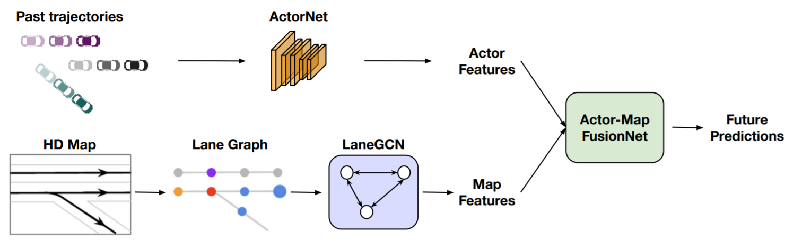
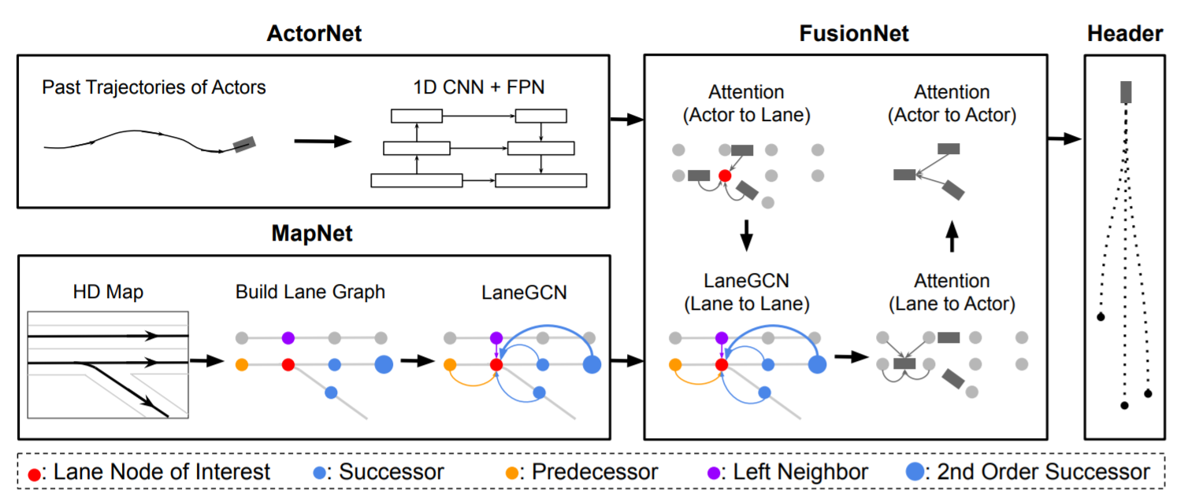
An example of SOTA solution: LaneGCN
History Encoding: 1D-ResNets with shared weights encode agents trajectories independently
HD-Map and Agents Interaction:
Graph CNN encodes HD-Map graph
Agents states influence lanes states by attention mechanism
Lanes update their states by another Graph CNN
Lanes states influence agents states by attention mechanism
Agents states influence each other by attention mechanism
Trajectory Forecasting and Diversity Prediction: Separate 1D-ResNets with shared weights predict trajectories for each agent
Each ResNet has several heads that predict multiple trajectories at once
The whole trajectory is forecasted at once by a big fully connected layer

Slide 24
Our task
We concentrate on three blocks: History Encoding and Trajectory Forecasting (necessary blocks) and Agents Interaction
HD-Map Encoding is too complex and computationally expensive. At the same time, there is only a small margin between methods with and without HD-Map
Trajectories of other agents allow to implicitly restore scene map
Good Diversity Prediction depends on good HD-Map encoding
Good Diversity Prediction is impossible without good Trajectory Forecasting
So the chosen three blocks are the main blocks in our opinion

